Slide 1
"Unit 7: "For Live Session"
Chad Madding

Slide 2
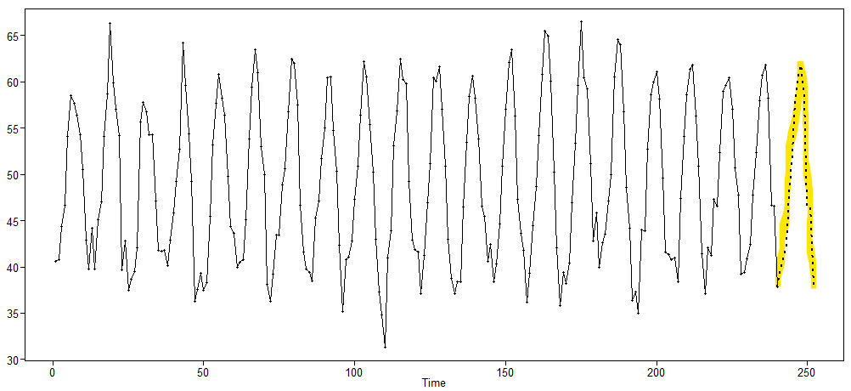
1. Which model do you think is appropriate to use to forecast your time series? Why? Add this to the Google Doc as well as to your PowerPoint deck.
Average Monthly Temperatures at Nottingham, 1920–1939
Forecasting with a seasonal model would do well with this average monthly temperature data from the Nottingham dataset.
#R Data
data(nottem)
plotts.sample.wge(nottem)
fore.aruma.wge(nottem,s=12,n.ahead=12,lastn=F,plot=T,limits=FALSE)

Slide 3
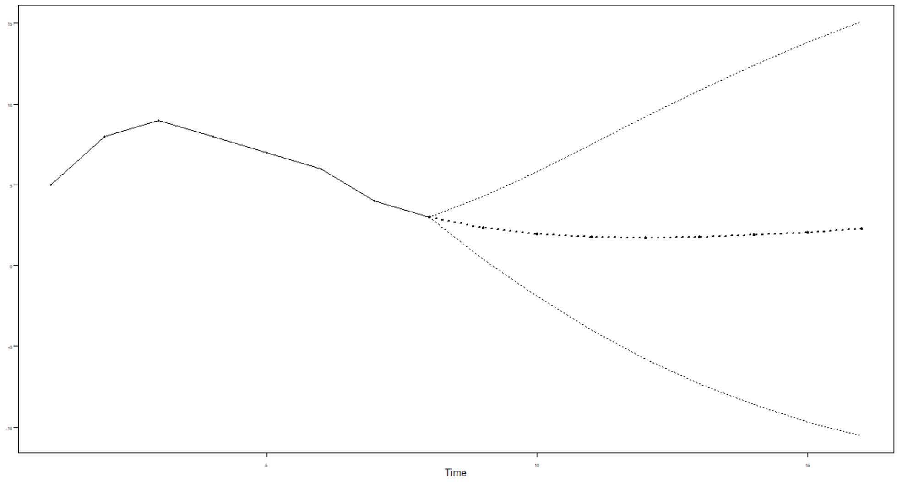
2. Find the first 5 psi weights for the model below, and use them to find the half-width of the 95 percentile probability interval for the third forecast (Xhat(3)). Please show your work as well as a plot of the series and the first eight forecasts with probability intervals. (1–.9B)(1–.8B)Xt =at X1 = 5 X2 = 8 X3 = 9 X4 = 8 X5 = 7 X6 = 6 X7 = 4 X8 = 3
7 For Live Session Question 2: provide white noise variance calc… page 246
x = c(5, 8, 9, 8, 7, 6, 4, 3)
#So the real formula is:
#(1-1.7B+0.72B^2)X_t = a_t
mult.wge(fac1 = -.9, fac2 = -.8)
#phi = c(1.7, -.72) needed mupliti the B's
live2=fore.arma.wge(x,phi = c(1.7, -.72), theta = 0,n.ahead = 8,limits=T, lastn = F)
#Find the first 5 psi weights
live2$psi[1:5]
#First 5 psi weights: 1.70000 2.17000 2.46500 2.62810 2.69297
#Provide white noise variance.
live2$wnv
#White Noise Variance = 0.9958917
#half width third forecast (Xhat(3))
(1.96*live2$wnv)*sqrt(1 + (live2$psi[1])^2 + (live2$psi[2])^2)
#The half width if the third forecast (Xhat(3)) = 5.723868
half_width1 = live2$ul[3] - live2$f[3]
half_width2 = live2$f[3] - live2$ll[3]
The first eight forecasts with probability intervals

Slide 4

3. Using the three models below and the Amtrak ridership data, which model has the smallest ASE in forecasting the next year (12 months)? MODEL 1 has the smallest ASE at 22588.56
Show your code in forecasting the 12 observations as well as in calculating the ASE.
MODEL 1: 22588.56
$$(1\text{+ }\text{0.5511}B\text{− 0.1680}B^{2}\text{+0.0145}B^{3}\text{− 0.0651}B^{4}\text{− 0.1388}B^{5}\text{+ 0.2966}B^{6}\text{− 0.1539}B^{7}\text{− 0.1270}B^{8}\text{+0.1815}B^{9}\text{− 0.0364}B^{10}\text{− 0.1456}B^{11}\text{− 0.6287}B^{12}\text{+ 0.3832}B^{13}\text{+ 0.0199}B^{14}\text{+ 0.1679}B^{15})X_{t}=a_{t}$$
phis: c(0.5511, 0.1680, -0.0145, 0.0651, 0.1388, -0.2966, 0.1539, 0.1270, -0.1815, 0.0364, 0.1456, 0.6287, -0.3832, -0.0199, -0.1679)
$MODEL 2:$17197.77
$$(1\text{+ }\text{0.027}1B\text{−0.7421}B^{2})(1−B^{12})X_{t}={(1\text{+ }\text{0}.5845B\text{− }0.3837B^{2})a}_{t}$$
phis: c(-0.02709541, 0.74213105)
thetas: c(-0.5844596, 0.3836931)
$MODEL 3:$ 18399.97
$$(1 − .3069B)(1−B)(1−B^{12})X_{t}={(1\text{− }0.7432B)a}_{t}$$
#MODEL 2 has the smallest ASE at 17197.77
Amtrak = read.csv("AmtrakPassengersMonthly.csv",header = TRUE)
#Convert to a Time Series
AmtrakTS = ts(Amtrak$Ridership)
plotts.wge(AmtrakTS)
plotts.sample.wge(AmtrakTS)
#MODEL 1:
M1_Amtrak = fore.arma.wge(AmtrakTS,phi=c(0.5511, 0.1680, -0.0145, 0.0651, 0.1388, -0.2966, 0.1539, 0.1270, -0.1815, 0.0364, 0.1456, 0.6287, -0.3832, -0.0199, -0.1679),n.ahead=12,limits=F, lastn = T)
M1_Amtrak_ASE = mean((M1_Amtrak$f-AmtrakTS[148:159])^2)
M1_Amtrak_ASE
#[1] 22588.56
#MODEL 2:
M2_Amtrak = fore.aruma.wge(AmtrakTS,phi=c(-0.02709541, 0.74213105),theta = c(-0.5844596, 0.3836931),s=12, n.ahead=12,limits=F, lastn = T)
M2_Amtrak_ASE = mean((M2_Amtrak$f-AmtrakTS[148:159])^2)
M2_Amtrak_ASE
#[1] 17197.77
#MODEL 3:
M3_Amtrak = fore.aruma.wge(AmtrakTS,phi=0.306943,theta = 0.7431719,d=1,s=12, n.ahead=12,limits=F, lastn = T)
M3_Amtrak_ASE = mean((M3_Amtrak$f-AmtrakTS[148:159])^2)
M3_Amtrak_ASE
#[1] 18399.97
phi: 0.306943
theta: 0.7431719

Slide 5
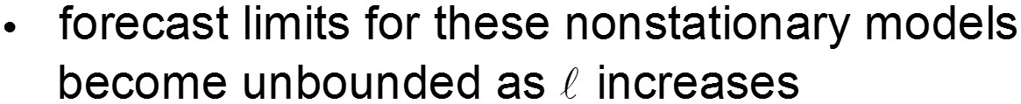
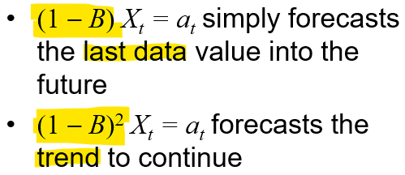
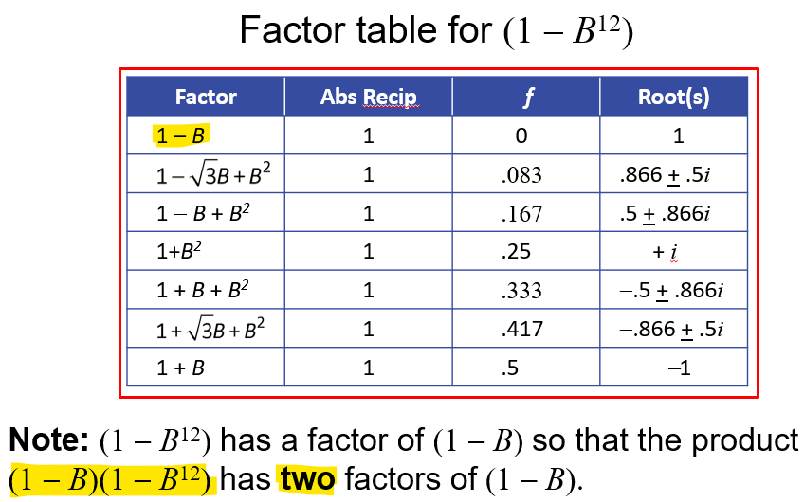
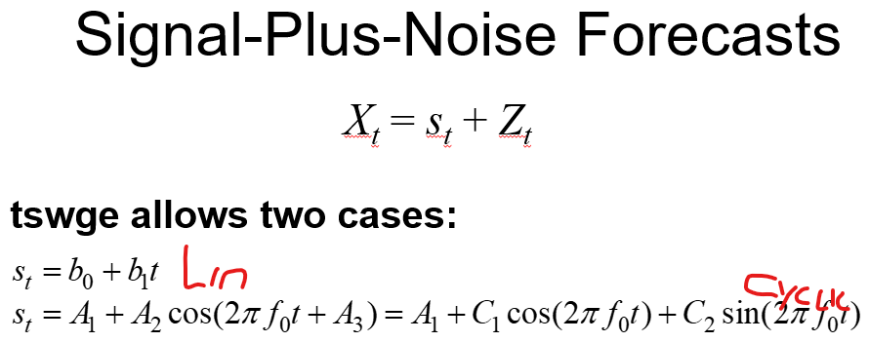

A brief reflection of thoughts and key takeaways – Week 7
Forecasting with ARIMA
Comments:
Forecasts the the last value
forecasts from these models are obtained using a method similar to that used for ARMA forecasts
we will not calculate these forecasts by hand but will typically use tswge function fore.aruma.wge
Forecasts the trend determined by the last two observations
Airline Model (Seasonal and Trend)
Note:
Nonstationary not attracted to the mean because of the wandering. So it zeros out Xbar in the equation.
Continues to forecast the last data value
Boring
But makes sense
Like flipping a coin – Just as likely to go up as down
My question for this week has to do with psi weights and white noise variance, basically all of question 2. Would you please go over how to figure white noise variance in R?

